Slide 1
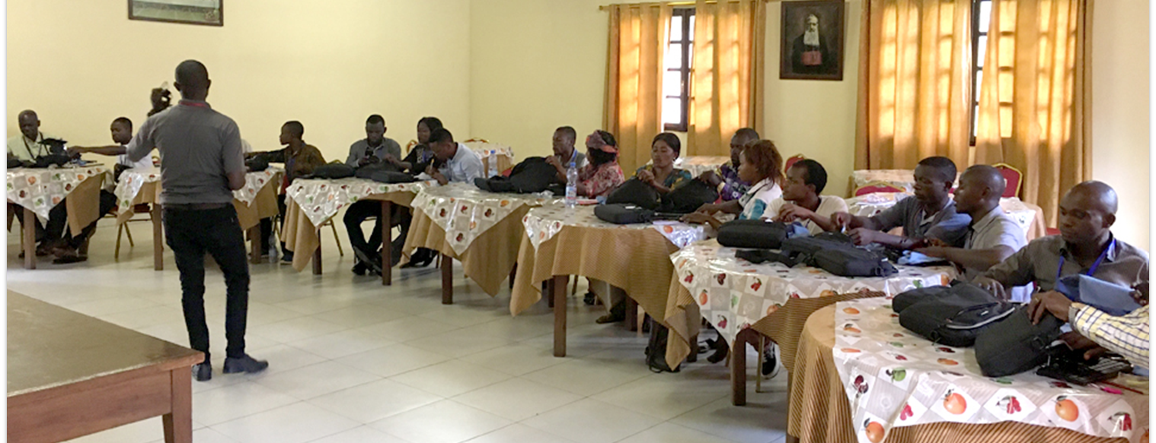
Without counsel, plans go awry, but in the multitude of counselors they are established (Prov. 15:22).
All Scripture is taken from the New King James Version®. © 1982 by Thomas Nelson, Inc. Used by permission. All rights reserved.
Workshop Planning

Slide 2

Prayer
Wisdom
Discernment
Accuracy
Unity
Good communication
Safety
Protection
Health
Engaging in Spiritual warfare

Slide 3
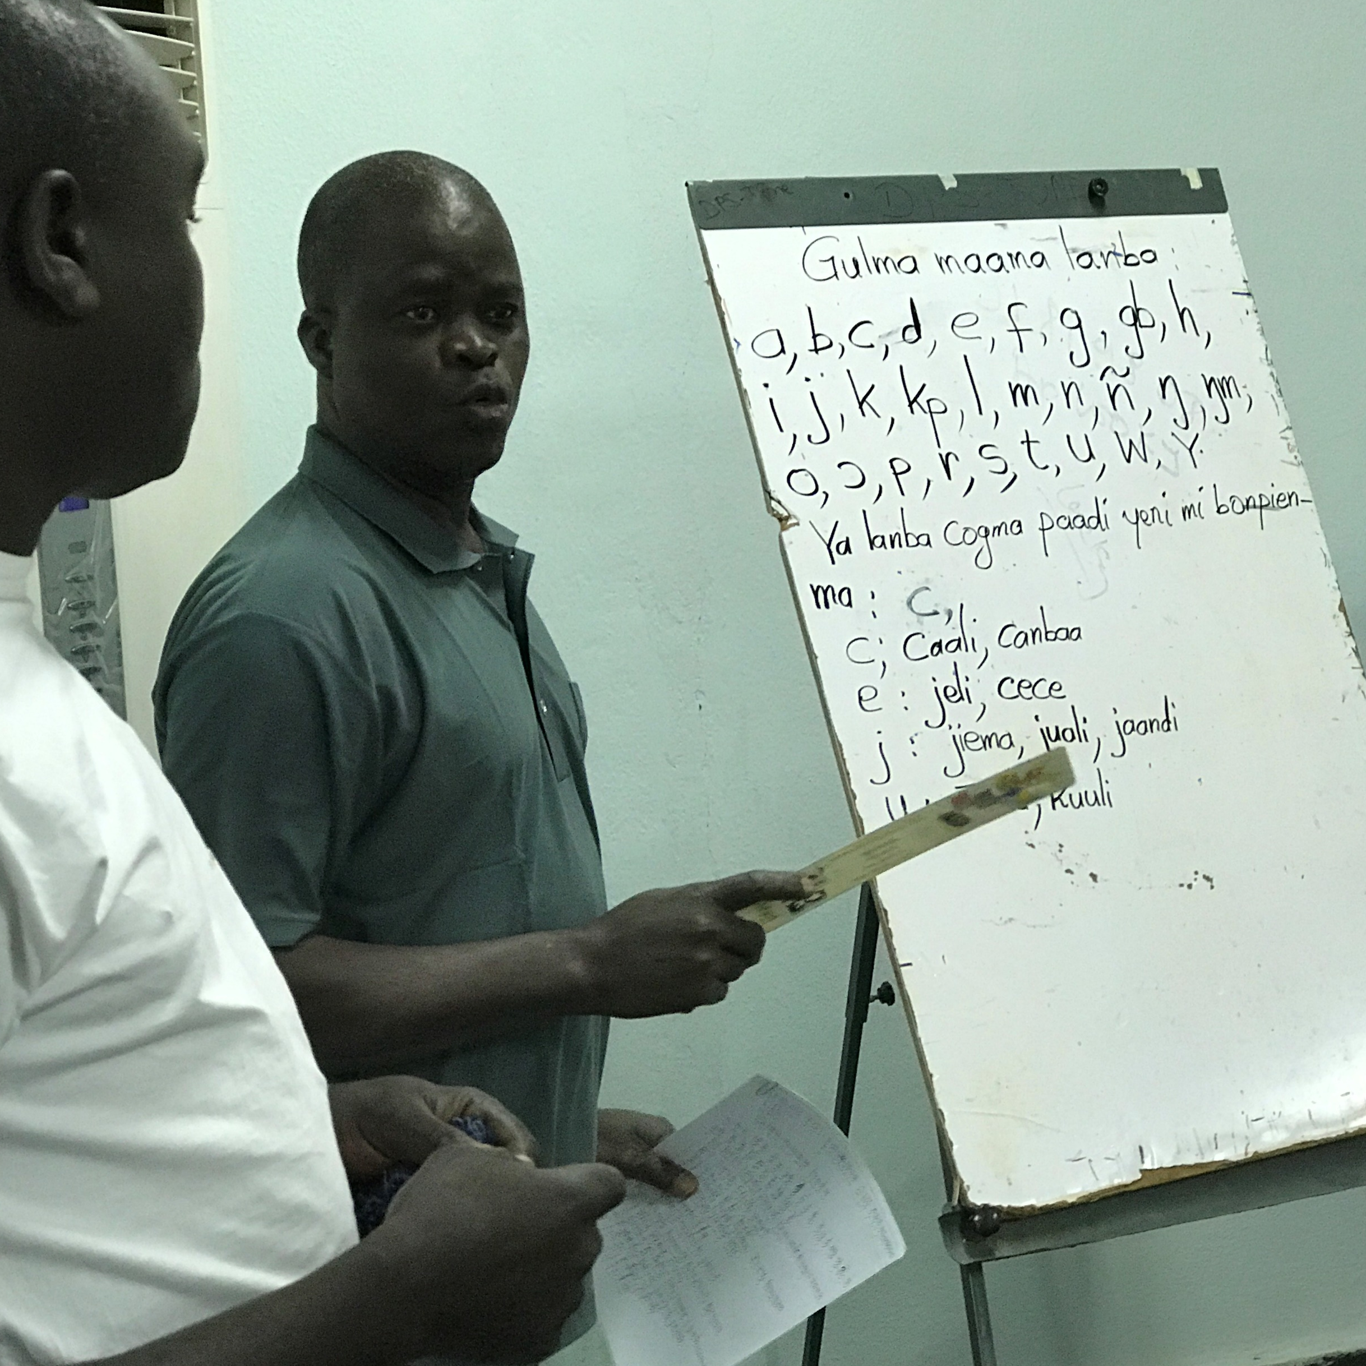
Leadership Roles
Teach/train
Inspire/motivate
Organize
Set goals
Gauge progress
Hold translators accountable
Communicate
Keeping track of…ALL the details

Slide 4

Inspirational Devotions
Revelation 5
Matthew 28:19
Genesis 11
God created languages
All languages will worship Him
Teaching to observe all things
Include translated verses each day

Slide 5

Meeting the Needs of Translators
Physical and spiritual/ interpersonal needs
Translators must function at the highest level of thought

Slide 6


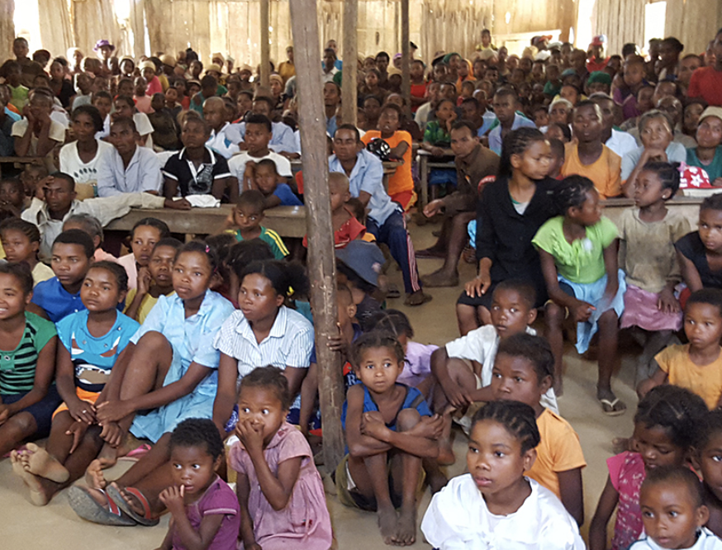





Hierarchy of Need (based on Maslow’s)
Focus on Ministry
Esteem
Needs
Love and Belonging
Needs
SafetyNeeds
Physical
Needs

Slide 7
James 2:15 –16
If a brother or sister is naked and destitute of daily food, ¹⁶ and one of you says to them, “Depart in peace, be warmed and filled,” but you do not give them the things which are needed for the body, what does it profit?

Slide 8
Values-Based Learning Instructors/Facilitators must show: Honesty Common Interest Praise Protection Service

Slide 9

Honesty
Therefore, putting away lying, “Let each one of you speak truth with his neighbor,” for we are members of one another.​ Ephesians 4:25

Slide 10

Common Interest
Therefore if there is any consolation in Christ, if any comfort of love, if any fellowship of the Spirit, if any affection and mercy, ² fulfill my joy by being like-minded, having the same love, being of one accord, of one mind.​ Philippians 2:1-2

Slide 11

Praise
Therefore comfort each other and edify one another, just as you also are doing.​ 1 Thessalonians 5:11

Slide 12

Protection
I have shown you in every way, by laboring like this, that you must support the weak. And remember the words of the Lord Jesus, that He said, ‘It is more blessed to give than to receive.’ ”​ Acts 20:35

Slide 13

Service
Yet it shall not be so among you; but whoever desires to become great among you, let him be your servant. ²⁷ And whoever desires to be first among you, let him be your slave— ²⁸ just as the Son of Man did not come to be served, but to serve, and to give His life a ransom for many.” Matthew 20:26-28

Slide 14
?
How has feeling valued helped you?
How have you expressed value to others?

Slide 15
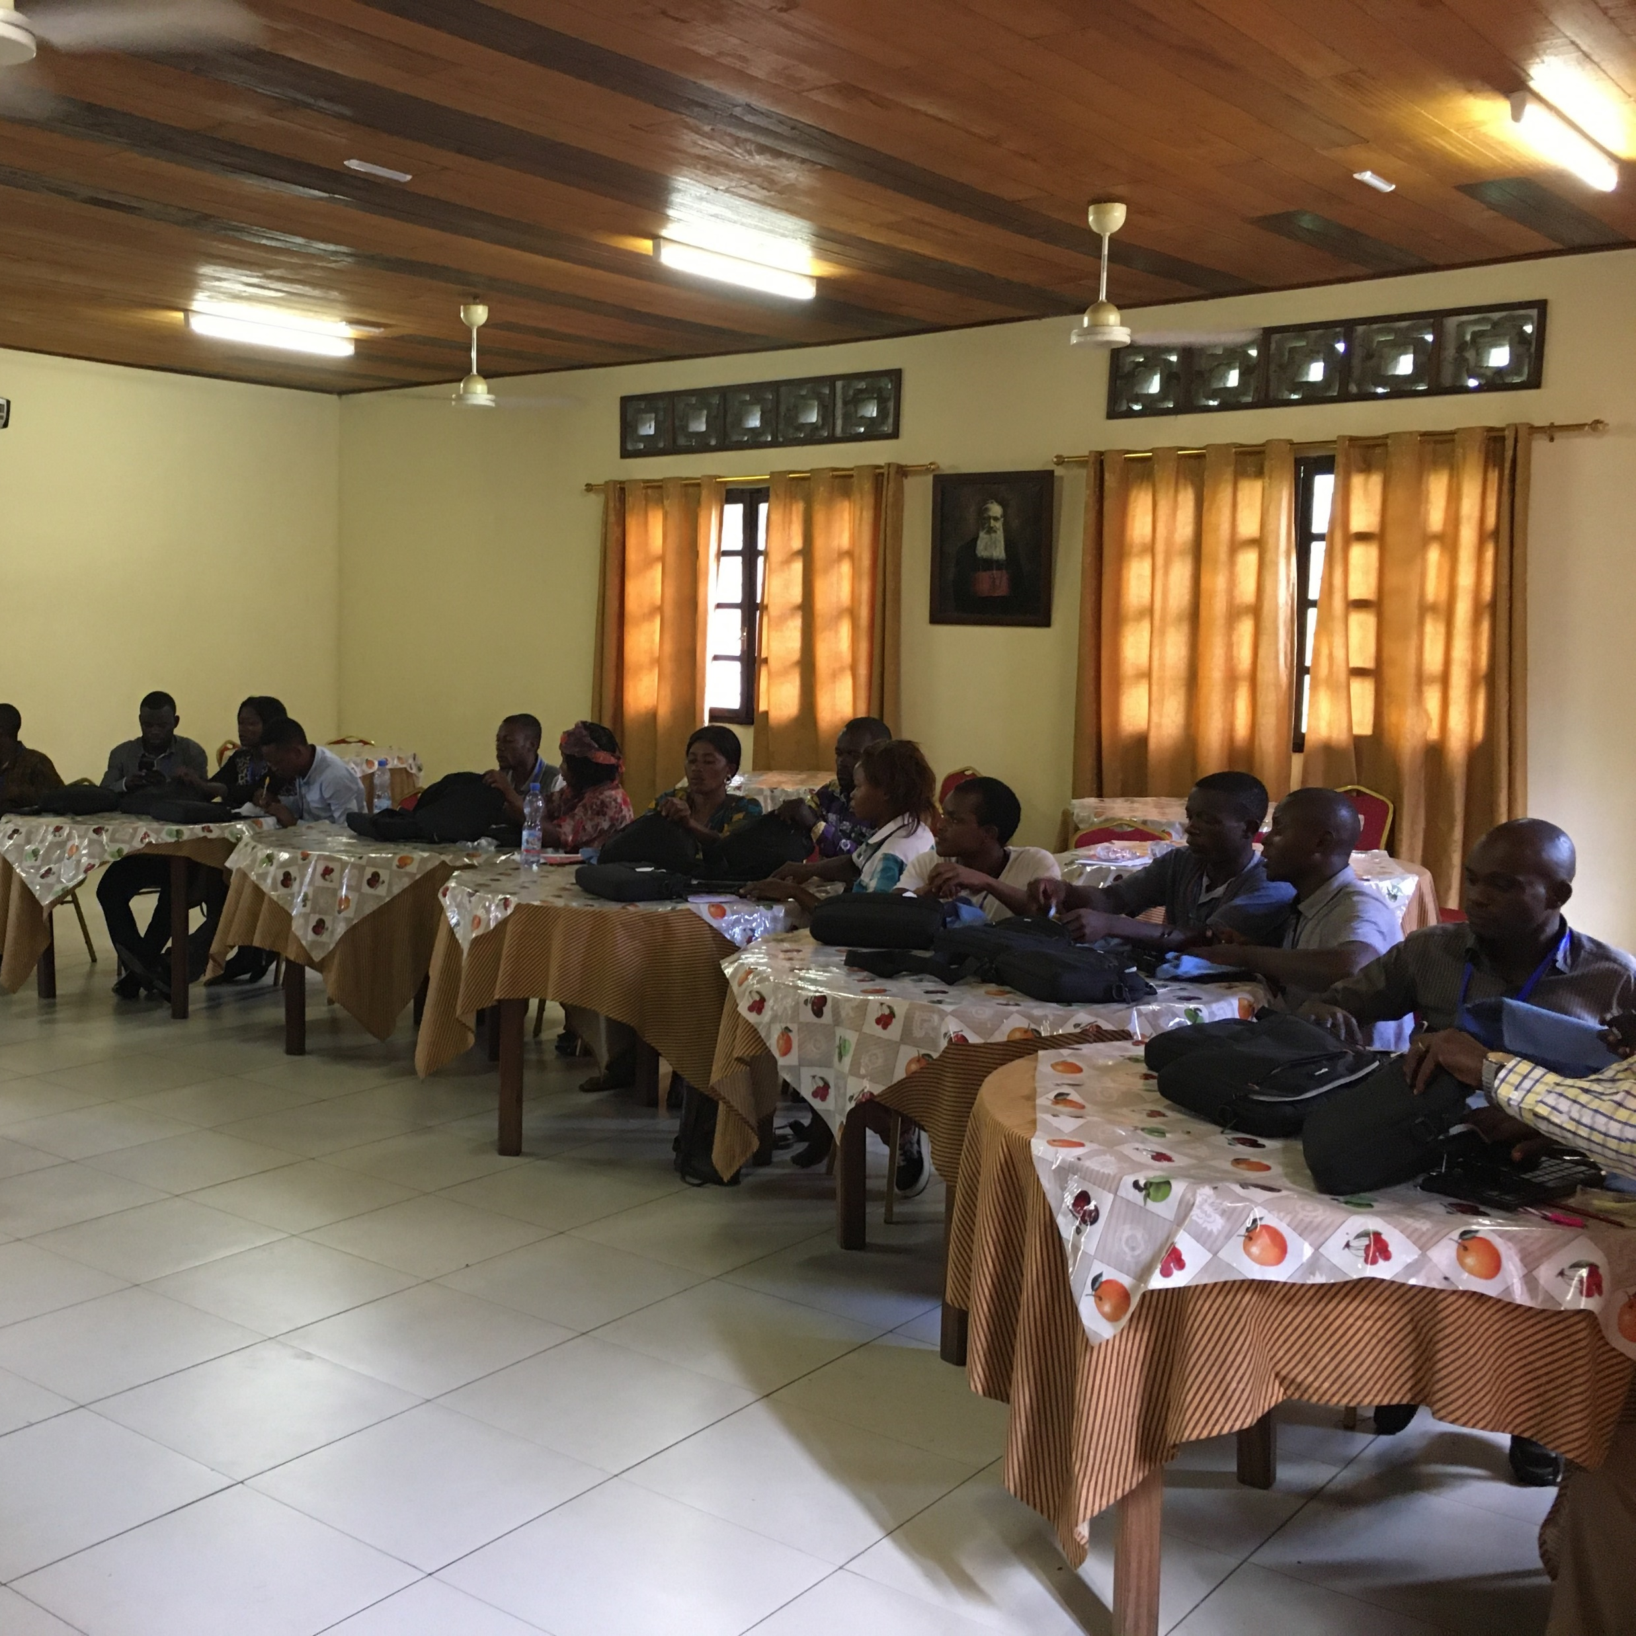
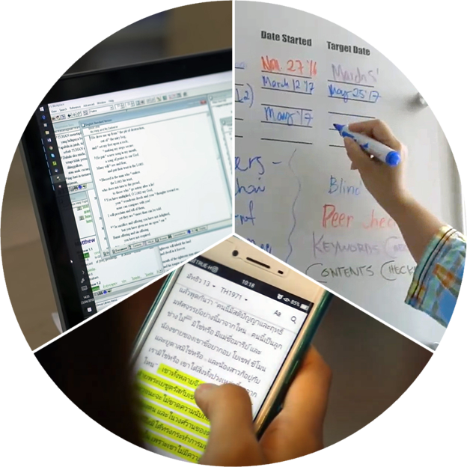
Location and Set-up
Practical workshop necessities
Consider the challenges of working from home

